Slide 1
Graphics

Slide 2
Graphics
A graphics context is encapsulated by the Graphics class and is obtained in two ways:
  It is passed to an applet when one of its various methods, such as paint( ) or update( ), is called.
  It is returned by the getGraphics( ) method of Component.
The Graphics class defines a number of drawing functions.
Each shape can be drawn edge-only or filled.
Drawing Lines
void drawLine(int startX, int startY, int endX, int endY)
Drawing Rectangles
void drawRect(int top, int left, int width, int height)
void fillRect(int top, int left, int width, int height)

Slide 3
Con’t
void drawRoundRect(int top, int left, int width, int height, int xDiam, int yDiam)
void fillRoundRect(int top, int left, int width, int height, int xDiam, int yDiam)
Drawing Ellipses and Circles
void drawOval(int top, int left, int width, int height)
void fillOval(int top, int left, int width, int height)
Drawing Arcs
void drawArc(int top, int left, int width, int height, int startAngle, int sweepAngle)
void fillArc(int top, int left, int width, int height, int startAngle, int sweepAngle)

Slide 4
Con’t
Angles are specified in degrees. Zero degrees is on the horizontal, at the three o’clock position.
The arc is drawn counterclockwise if sweepAngle is positive, and clockwise if sweepAngle is negative.
Therefore, to draw an arc from twelve o’clock to six o’clock, the start angle would be 90 and the sweep angle 180.
Drawing Polygons
void drawPolygon(int x[ ], int y[ ], int numPoints)
void fillPolygon(int x[ ], int y[ ], int numPoints)
GraphicsDemo.java

Slide 5
Color
Color defines several constants
E.g. Color.black
Constructors
Color(int red, int green, int blue)
  Values must be between 0 and 255.
  E.g. new Color(255, 100, 100); // light red.
Color(int rgbValue)
Color(float red, float green, float blue)
Methods
static int HSBtoRGB(float hue, float saturation, float brightness)
static float[ ] RGBtoHSB(int red, int green, int blue, float values[ ])
Hue - the hue component of the color
Saturation - the saturation of the color
Brightness - the brightness of the color

Slide 6
Con’t
int getRed( )
int getGreen( )
int getBlue( )
int getRGB( )
void setColor(Color newColor)
Color getColor( )
DrawingStuff.java
In graphics,
void setPaintMode( ) // By default, new output to a window overwrites any preexisting contents.
void setXORMode(Color xorColor)
SetXORPaintModeExample.java

Slide 7
Fonts
Variable
String name : Name of the font
float pointSize : Size of the font in points
int size : Size of the font in points
int style : Font style
The family name is the general name of the font, such as Courier.
The logical name specifies a category of font, such as Monospaced.
The face name specifies a specific font, such as Courier Italic.( Italic is optional)
The name can be specified using either the logical or face name.

Slide 8
Con’t
Constructor
Font(String fontName, int fontStyle, int pointSize)
  Font face Name - Helvetica Bold
  "Helvetica” and “Helvetica Bold” -family named "Helvetica”
  Logical fontName - Dialog, DialogInput, Sans Serif, Serif, Monospaced.
    Dialog is the default.
  fontStyle - Font.PLAIN, Font.BOLD, and Font.ITALIC
  E.g. Font helvb14 = new Font("Helvetica", Font.BOLD, 14);
void setFont(Font fontObj) //Defined in Component class
Font getFont( ) // Defined by Graphics class

Slide 9
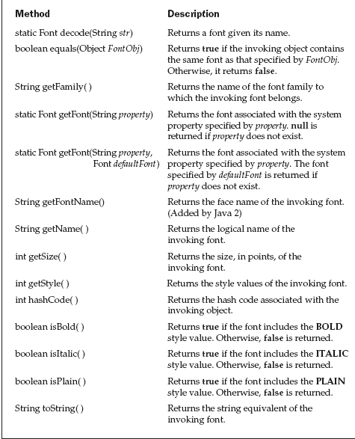
Font Class methods

Slide 10
Graphics 2D

Slide 11
Graphics2D
Graphics2D class is a subclass of the Graphics class.
  java.awt.Graphics2D class
  public void paint(Graphics g) {
  Graphics2D g2 = (Graphics2D) g; . . .
  }
The Java 2D library organizes geometric shapes in an object-oriented fashion.
  java.awt.geom
    Line2D
    Rectangle2D
    RoundRect2D
    Ellipse2D
    Arc2D …

Slide 12
Con’t
Rectangle2D rect = new Rectangle2D();
setRect(10,10,30,40);
g2.draw(rect);
The Java 2D shapes use floating-point coordinates(double type parameters and return types of methods).
If want to use float type then need to cast.
  float f = 1.2; // Error
  float f = 1.2F; // Ok
  Rectangle2D r = new Rectangle2D();
  float f = r.getWidth(); // Error
  float f = (float) r.getWidth(); // Ok

Slide 13
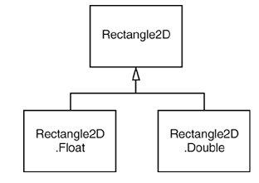
Con’t
Consider the Rectangle2D class.
This is an abstract class with two concrete subclasses, which are also static inner classes:
  Rectangle2D.Float
  Rectangle2D.Double
Rectangle2D.Float floatRect = new Rectangle2D.Float(10.0F, 25.0F, 22.5F, 20.0F);
Rectangle2D.Double doubleRect = new Rectangle2D.Double(10.0, 25.0, 22.5, 20.0);
Rectangle2D floatRect = new Rectangle2D.Float(10.0F, 25.0F, 22.5F, 20.0F); Rectangle2D doubleRect = new Rectangle2D.Double(10.0, 25.0, 22.5, 20.0);

Slide 14
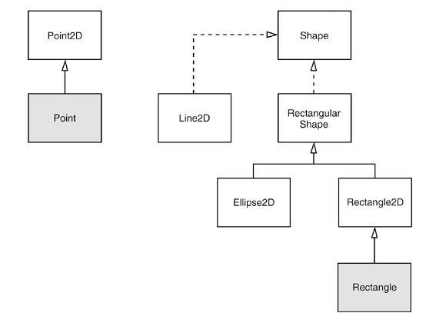
Relationships between the shape classes
AWTGraphicsDemo.java

Slide 15
java.awt.geom.RectangularShape
double getCenterX()
double getCenterY()
double getMinX()
double getMinY()
double getMaxX()
double getMaxY()
  return the center, minimum, or maximum x- or y-value of the enclosing rectangle.
double getWidth()
double getHeight()
  return the width or height of the enclosing rectangle.
double getX()
double getY()
  return the x- or y-coordinate of the top-left corner of the enclosing rectangle.

Slide 16
Con’t
java.awt.geom.Rectangle2D.Double
Rectangle2D.Double(double x, double y, double w, double h)
  constructs a rectangle with the given top-left corner, width, and height.
java.awt.geom.Rectangle2D.Float
Rectangle2D.Float(float x, float y, float w, float h)
  constructs a rectangle with the given top-left corner, width, and height.
java.awt.geom.Ellipse2D.Double
Ellipse2D.Double(double x, double y, double w, double h)
  constructs an ellipse whose bounding rectangle has the given top-left corner, width, and height.

Slide 17
Con’t
java.awt.geom.Point2D.Double
Point2D.Double(double x, double y)
  constructs a point with the given coordinates
java.awt.geom.Line2D.Double
Line2D.Double(Point2D start, Point2D end)
Line2D.Double(double startX, double startY, double endX, double endY)
  construct a line with the given start and end points.

